Slide 1
Used Car: Price-Prediction
By : Deepak kr. Singh

Slide 2
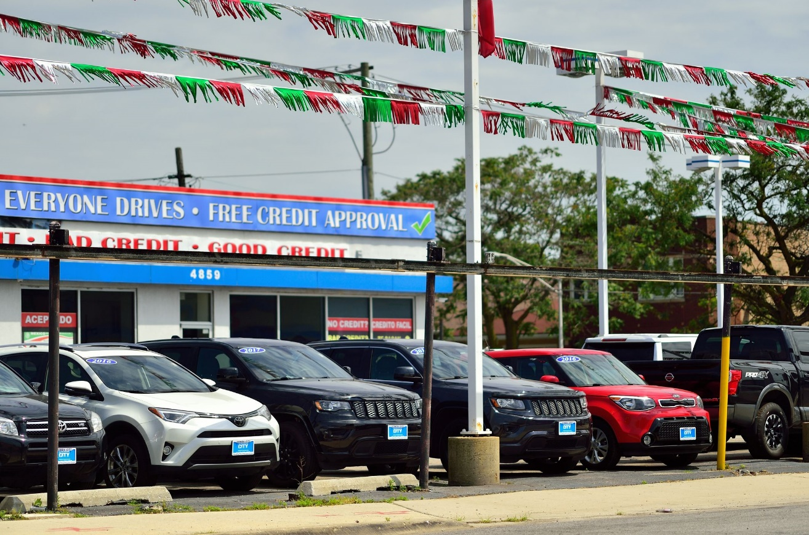
Car become basic requirement in this fast and dynamic world

Slide 3
Introduction:
Car has become basic requirement of every person in this fast and dynamic world
More consumers are looking at second-hand entry-level cars as opposed to buying new cars, this has taken a major chunk out of new car sales, It’s a trend grown.
Web scraping using website Cars24 and data of scraped price of a used car
Used cars selling more than new cars in India! To be world’s third largest market.
In the last year, demand for used cars has soared with over 42 lakh buyers (Source: CRISIL).
In “The Indian Express” quotes a study by Mckinsey, that projected India to 3rd largest market of used-cars by 2021.

Slide 4
Understanding Problem
The dataset has been scraped from website Cars24 this data is only for academic use, not for any commercial.
The dataset describe data related to cars with 5000+ records.
There are various topics on which the prediction can be applied like: (Model, Price, Location, Fuel, Driven(Km), EMI)
Model will be good for management to understand the pricing or the requirement of this dynamic new market.
Understanding of past, present and the future of used car by analysing previous market trends and price ranges, upcoming developments future prices will be predicted.

Slide 5
Dataset contain
Car details
Model building
Car-Brand
Model
Price
Location
Fuel
Driven(Kms)
EMI
Analyze dataset of Car Price Prediction.
EDA steps for cleaning the dataset.
Overall analysis of problem.
Model building from train & test.
Predicting Car Price for test section.

Slide 6
Things before buying a Used Car
Locating your dream car
Inspection of car (Filter conditions, Fluid levels, Brake integrity, Tire health)
Finalizing on the price
Transferring of ownership (such as RC book, Insurance note, Emission certificate)
Deciding on the price to be quoted buying a car is a cumbersome and complicated task as involves so many factors
First decide about your priority of car, i.e. whether you are looking for a particular brand or a car which suits your traveling needs then decide.
Check on classifieds sites to get an idea on the quoted price for particular models and year of make along with accessories present.
Use the above checklist to counter offer the seller’s price.

Slide 7
Price Prediction :
Car Price prediction, is important for both buyer & dealer.
Prediction car prices are expected to help people who plan to buy a car so they can know the price range.
The model will also used by the management of car selling company to understand how exactly the price vary with the variable and what are the requirement of customers.

Slide 8
Exploratory data analysis.
Steps Involved:
Importing the required packages into our python
Importing the house price data and do some EDA
Data Visualization on the house price data
Feature Selection & Data Split
Modeling the data using the algorithms
Evaluating the built model using the evaluation metrics

Slide 9
Data Cleaning and model building
In my datasets I found null values, outliers and also skewness.
Imputation method to replace null values. To remove outliers used z-score method, and to remove skewness used yeo-johnson method.
To encode the categorical columns; uses Label Encoding.
Also used standardization. Then model building with all regression algorithms.

Slide 10
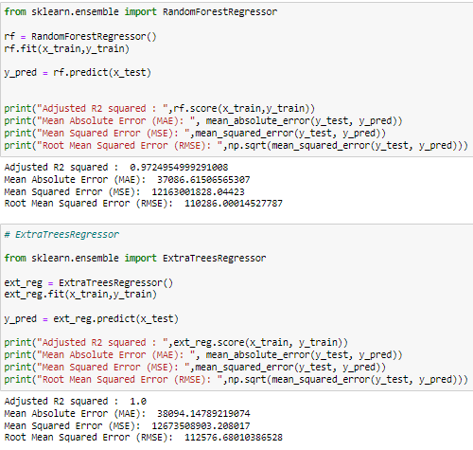
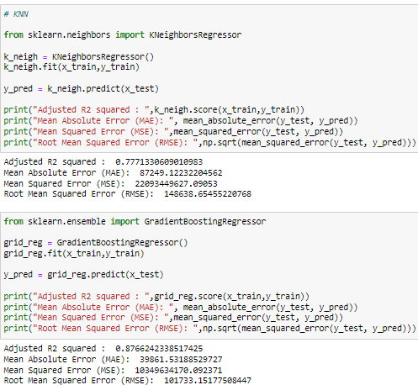
Model Performance

Slide 11
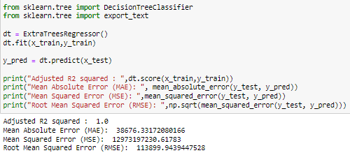
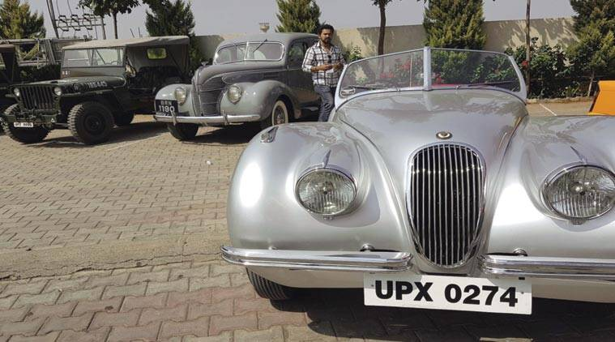
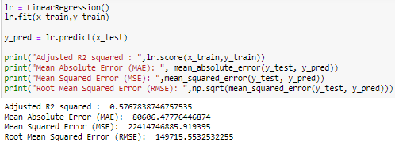
Model building
Price was my target and it was a continuous column so this perticular problem was regression problem. And I have used all regression algorithms to build my model. By looking into the difference of r2 score and cross validation score I found Gradient Boosting Regressor as a best model.

Slide 12
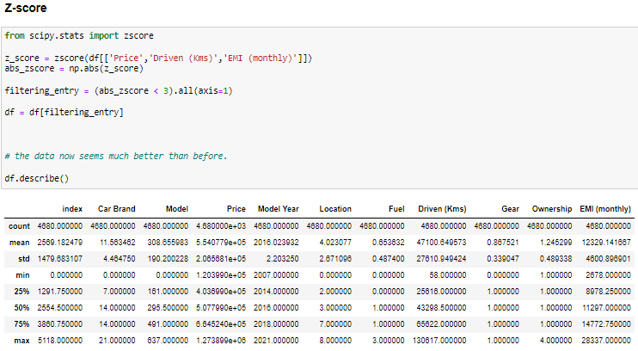
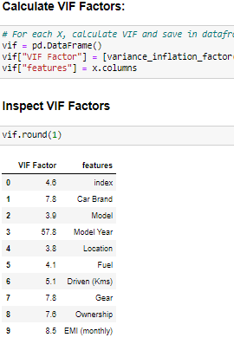
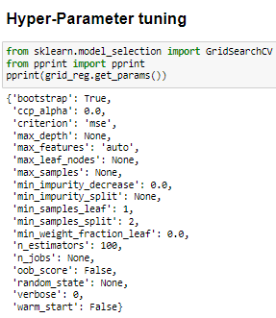
Imputation methods

Slide 13
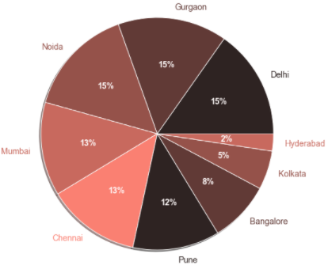
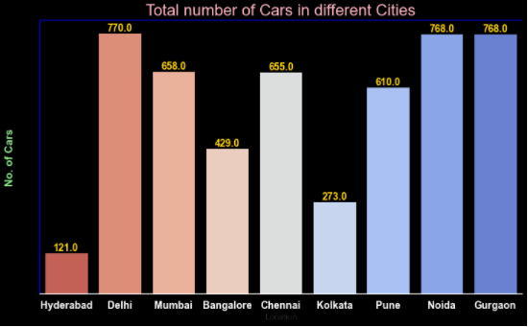
Visualization
Total number of cars in different Cities
Percentage of cars available for sale in different cities:

Slide 14
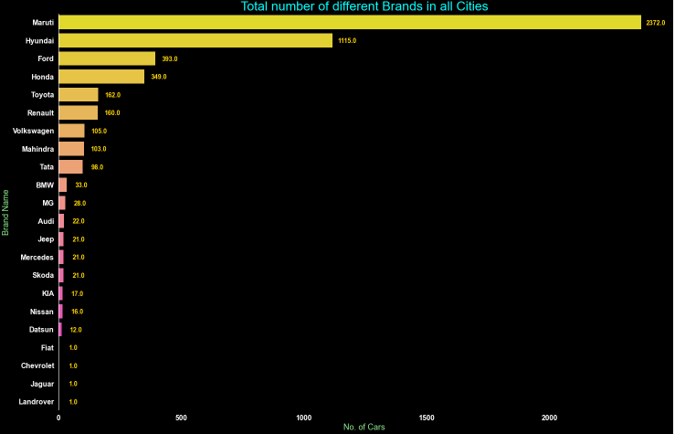
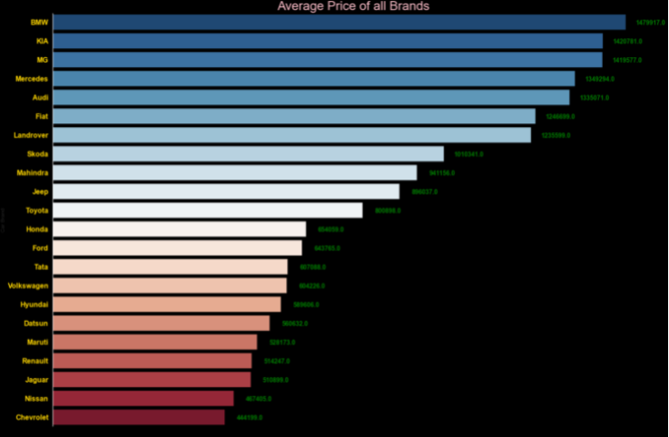
Average Price all the brands of cars and total no. of cars

Slide 15
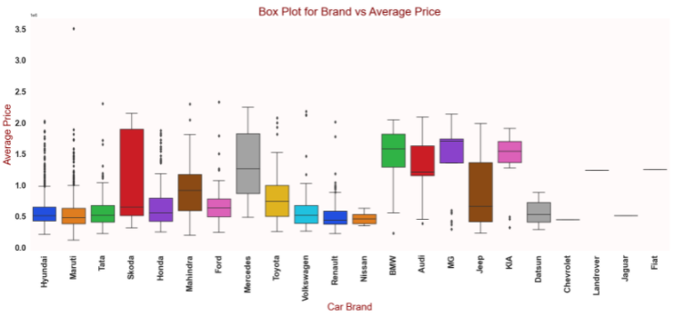
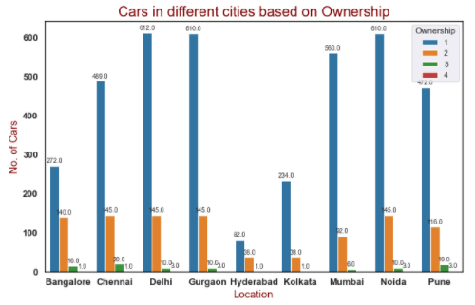
Car Brand vs Average Price
Number of Cars in different cities based on Ownership:

Slide 16
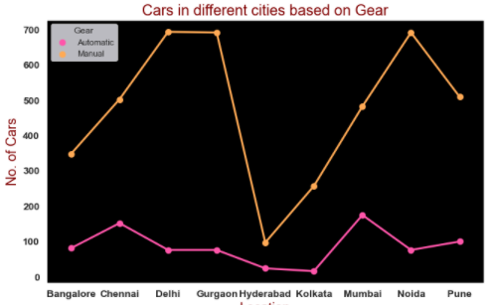
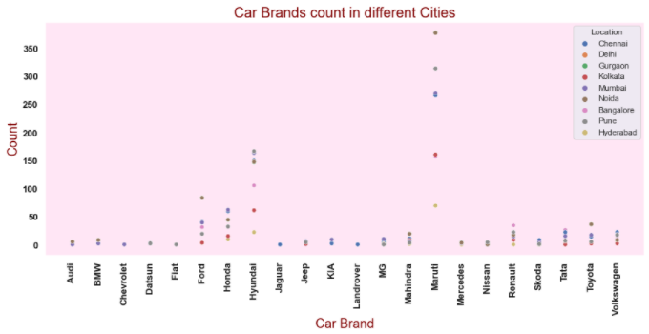
Cars in different brands of cars cities based on Gear (i.e: Automatic / Manual)

Slide 17
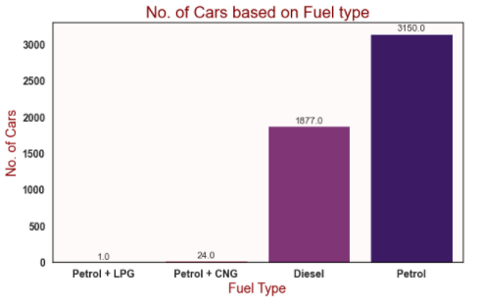
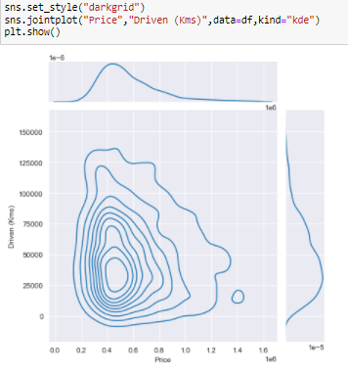
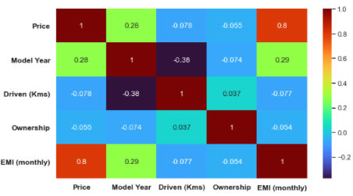

Slide 18
Observation
Cars manufactured in mumbai have higher price whereas in kolkata price is cheapest.
Car having 1st or 2nd owner have higher price as they are well maintained.
The availability of cars in 'Delhi'(2200+) is the highest among other cities
Car having fule type as diesel have higher price.
Automatic cars are costlier than manual.
Cars having insuarance type as "Zero Depriciation" have higher price.

Slide 19
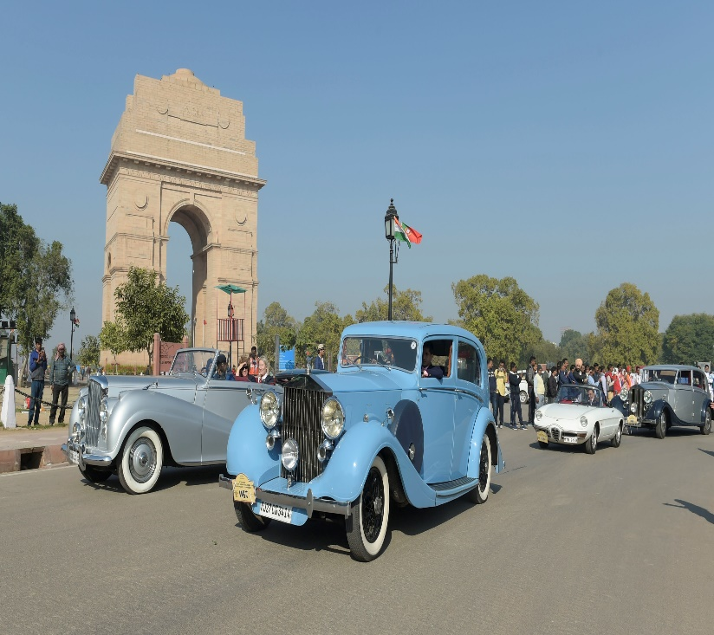
Conclusion
With this segment India projected to be the 3rd largest market for used-cars by 2021.
After the pandemic this projection says “India will be the biggest market for the used cars”.
The increased prices of new cars and the financial incapability of the customers to buy them, Used Car sales are on a global increase.
The availability of cars in 'Delhi'(2200+) is the highest
Maruti Suzuki has always been the top choice of used car buyers and widely available, count of 2800+
Manly cars runs with 'Petrol' with a count of 3191.
High budget car among all cities: Toyota , in Mumbai
Low budget car among all cities: Maruti AltoLX, etc.

Slide 20
